Slide 1
The lecture 11
Exception handling

Slide 2
Adding textboxes

Slide 3
Adding context Menu and errorprovider

Slide 4
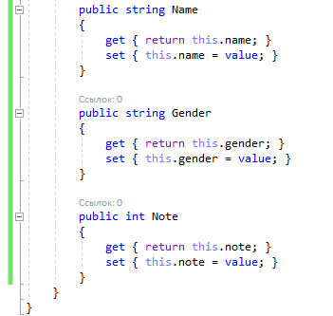
Creating a new class

Slide 5
Adding error messages

Slide 6
Enter the form’s validation

Slide 7
Adding context menu actions

Slide 8
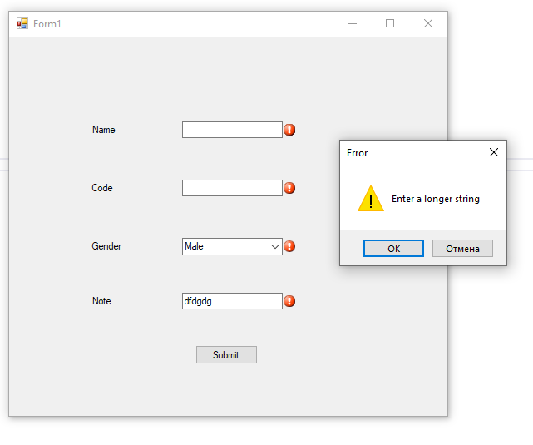
Form errors

